Slide 1
Introduction To Spring Framework
Spring Framework is a comprehensive and versatile(able to adapt) platform for enterprise Java development.
It is known for its Inversion of Control (IoC) and Dependency Injection (DI) capabilities that simplify creating modular and testable applications.
Key features include:
Spring MVC for web development
Spring Boot for rapid application setup
Spring Security for robust authentication and authorization
Spring Data for database interactions
Spring Cloud for building microservices

Slide 2
What is Spring Framework?
Spring is a lightweight and popular open-source Java-based framework developed by Rod Johnson in 2003, and it was first released under the Apache 2.0 license in June 2003.
It is used to develop enterprise-level applications.
It provides support to many other frameworks such as Hibernate, Tapestry, EJB, JSF, Struts, etc.
So, It is also called a framework of frameworks.
It’s an application framework and IOC (Inversion of Control) container for the Java platform. The spring contains several modules like IOC, AOP, DAO, Context, WEB MVC, etc.

Slide 3
Why to use Spring?
Spring framework is a Java platform that is open source. When it comes to size and transparency, Spring is a featherweight. Spring framework's basic version is about 2MB in size.
The Spring Framework's core capabilities can be used to create any Java program, however there are modifications for constructing web applications on top of the Java EE platform. By offering a POJO-based programming model, the Spring framework aims to make J2EE development easier to use and to promote good programming habits.

Slide 4
Applications of Spring
POJO Based: Spring allows developers to use POJOs to create enterprise-class apps. The advantage of using simply POJOs is that you don't require an EJB container product like an application server; instead, you may use a powerful servlet container like Tomcat or a commercial product.
Modular: Spring is set up in a modular approach. Even if there are a lot of packages and classes, you only need to worry about the ones you need and ignore the rest.
Spring works well with other tools: Instead of creating everything from scratch, it uses:
ORM tools (for database access)
Logging tools (to track what’s happening)
Java EE features
Quartz and JDK timers (for scheduling tasks)
Various view technologies (for building user interfaces)

Slide 5
Spring makes testing easy. It separates code that depends on the environment, so you can test your app without needing the full setup. Plus, it uses simple Java objects (POJOs), which makes it easy to add fake data for testing using dependency injection.
Web MVC: Spring's web framework is a well-designed web MVC framework that is an excellent alternative to web frameworks like Struts and other over-engineered or less popular web frameworks.
Central Exception Handling: Spring provides a handy API for converting technology-specific exceptions (such as those raised by JDBC, Hibernate) into consistent, unchecked exceptions.
Lightweight: IoC containers are typically lightweight, especially when compared to EJB containers, for example. This is useful for creating and distributing programmers on systems with limited memory and CPU resources.

Slide 6
Benefits of Using Spring Framework
Simplified Development: Spring reduces boilerplate code with features like Dependency Injection and AOP, making development faster and easier.
Loose Coupling: Dependency Injection ensures components are loosely coupled, improving maintainability and testability.
Modular: Spring's modular architecture allows developers to use only the required components, improving flexibility and efficiency.
Integration Support: Spring provides built-in support for various technologies like JDBC, JPA, making integration with other systems seamless.
Scalability: Spring's lightweight nature and support for various web and enterprise components make it highly scalable for large applications.

Slide 7
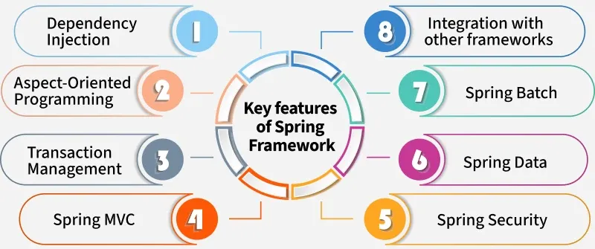
Key Features of Spring Framework

Slide 8
Dependency Injection: Dependency Injection is a design pattern where the Spring container automatically provides the required dependencies to a class, instead of the class creating them itself. This promotes loose coupling, easier testing, and better maintainability by decoupling the object creation and usage.
Aspect-Oriented Programming (AOP): AOP allows developers to separate cross-cutting concerns (such as logging, security, and transaction management) from the business logic.
Transaction Management: Spring provides a consistent abstraction for managing transactions across various databases and message services.

Slide 9
Spring MVC: It is a powerful framework for building web applications that follow the Model-View-Controller pattern.
Spring Security: Spring provides security features like authentication, authorization, and more.
Spring Data: Spring Data is a part of the Spring Framework that simplifies database access by providing easy-to-use abstractions for working with relational and non-relational databases.
Spring Batch: Spring Batch is a framework in Spring for handling large-scale batch processing, such as reading, processing, and writing data in bulk.
Integration with Other Frameworks: Spring integrates seamlessly with other technologies like Hibernate, JPA and more, making it versatile for various enterprise applications.

Slide 10
Core Concepts of Spring Framework
1. Dependency Injection
Dependency Injection is a design pattern used in software development to implement Inversion of Control. It allows a class to receive its dependencies from an external source rather than creating them within the class. This reduces the dependency between classes and makes the system more maintainable.
Types of Dependency Injection
a. Constructor Injection: In constructor injection, the dependent object is provided to the class via its constructor. The dependencies are passed when an instance of the class is created.

Slide 11
Example: This example demonstrates, the Car class depends on the Engine class, and the dependency is provided via the constructor.
// Constructor Injection
public class Car {
private Engine engine;
public Car(Engine engine) {
this.engine = engine;
}
}

Slide 12
b. Setter Injection: In setter injection, the dependent object is provided to the class via a setter method after the class is instantiated. This allows you to change the dependencies dynamically.
Example: This example, demonstrates the Car class receives the Engine class through a setter method, which is called after the Car object is created.
// Setter Injection
public class Car {
private Engine engine;
public void setEngine(Engine engine) {
this.engine = engine;
}
}

Slide 13
c. Field Injection: In field injection, the dependent object is directly injected into the class through its fields. It is done using framework like Spring(via annotations). The Dependency Injection automatically injects the dependency without requiring explicit constructor or setter methods.
Example: This example, demonstrates the Engine class is injected directly into the Car class through its field, using annotations or DI frameworks.
// Field Injection
public class Car {
@Autowired
private Engine engine;
}

Slide 14
2. Inversion of Control (IOC)
In the Spring Framework, IoC (Inversion of Control) and the IoC Container are fundamental concepts that simplify object management and dependency injection.
IoC: Inversion of Control (IoC) is a design principle in Java (and other programming languages) that promotes loose coupling between components by delegating the control of object creation and dependency management to a container or framework. It is a core concept in frameworks like Spring.

Slide 15
In Simple Terms :
In Spring, Inversion of Control (IoC) means that the framework controls the creation and management of objects, rather than the developer doing it manually.
Here's a simple explanation:
Normally, you might write code like new MyService() to create an object.
With IoC, Spring creates that object for you and injects it where needed.
This is done using Dependency Injection (DI) — a key part of IoC.

Slide 16
Key Concepts of IoC:
Control Delegation: Instead of the application code controlling the flow and dependencies, the IoC container takes over this responsibility.
Dependency Injection (DI): IoC is often implemented using DI, where the container injects required dependencies into objects.
Benefits of IoC:
Loose Coupling: Components are less dependent on each other, making the code easier to maintain and test.
Reusability: Promotes reusable and modular code.
Simplified Configuration: Centralized management of dependencies.

Slide 17
Example in Spring Framework:
In Spring, the IoC container manages the lifecycle of beans (objects) and their dependencies. Here's a simple example:
Without IoC:
public class Car {
private Engine engine;
public Car() {
this.engine = new Engine(); // Tight coupling
}
}

Slide 18
With IoC (Using Dependency Injection):
public class Car {
private Engine engine;
// Dependency is injected via constructor
public Car(Engine engine) {
this.engine = engine;
}
}
The Spring IoC container would create and inject the Engine object into the Car object, removing the need for the Car class to manage its own dependencies.
This approach makes your code more flexible, testable, and easier to maintain.

Slide 19
Inversion of Control (IoC) (In Short) :
Definition: IoC is a design principle where the control of object creation, configuration, and lifecycle management is transferred from the application code to a container or framework.
Purpose: It decouples the application components, making the code more modular, testable, and easier to maintain.
How it works: Instead of creating objects manually in your code, you define the dependencies in a configuration file (XML, annotations, or Java-based configuration), and the IoC container takes care of injecting those dependencies.

Slide 20
IoC Container in Spring
The IoC (Inversion of Control) Container is a core component of the Spring Framework. It is responsible for managing the lifecycle of beans, including their instantiation, configuration, and assembly. The IoC container uses Dependency Injection (DI) to manage the components that make up an application.
Spring Container is the implementation of the IoC container within the Spring Framework. It’s how Spring actually delivers the inversion of control mechanism.

Slide 21
Spring Container
In Java, the Spring Container is a core concept of the Spring Framework. It is responsible for managing the lifecycle, configuration, and dependencies of the objects (known as beans) in a Spring application. The container uses Dependency Injection (DI) to wire objects together and provides a consistent way to manage application components.
Key Features of the Spring Container:
Bean Management: It creates, configures, and manages the lifecycle of beans.
Dependency Injection: Automatically injects dependencies into beans at runtime.
Configuration Support: Supports multiple configuration styles, including XML, annotations, and Java-based configuration.
Inversion of Control (IoC): The container takes control of object creation and dependency management, reducing boilerplate code.

Slide 22
Types of IoC Containers | Spring Containers
1. BeanFactory: The most basic version of the IoC container, providing the fundamental features of dependency injection. Suitable for lightweight applications with minimal configuration. A basic IoC container (lazy initialization).
2. ApplicationContext: Extends BeanFactory and adds more enterprise-specific functionality such as integration with Spring's AOP, message resource handling, event propagation, and application layer-specific contexts (e.g., WebApplicationContext). A more advanced container (eager initialization).
Common implementations:
ClassPathXmlApplicationContext: Loads configuration from an XML file in the classpath.
AnnotationConfigApplicationContext: Uses Java-based configuration with annotations.
FileSystemXmlApplicationContext: Loads configuration from an XML file in the file system.

Slide 23
Note : So, yes, the Spring Container is an IoC container—but not all IoC containers are Spring Containers.
Think of:
Vehicle = Concept (IoC)
Car, Bike, Bus = Implementations (Spring containers)
Maruti Swift (Car), Honda Activa (Bike) = Specific implementations (ApplicationContext, BeanFactory)
Note :
IoC is a concept
Spring Container is its implementation
BeanFactory & ApplicationContext are types of that implementation

Slide 24
Quick Comparison
👉 Use ApplicationContext for almost all Spring applications.
👉 Use BeanFactory only if you have a very specific reason to keep things minimal.
Feature | BeanFactory | ApplicationContext
Bean loading | Lazy | Eager
Configuration style | Mostly XML | XML, annotations, Java
Event handling | ❌ Not supported | ✅ Supported
AOP & lifecycle support | ❌ Limited | ✅ Full support
Common usage | Rare | Standard in Spring apps

Slide 25
3. Spring Annotation
@Component: Marks a class as a Spring bean, allowing Spring to automatically detect and manage it during classpath scanning.
@Autowired: Automatically injects dependencies into a class. It can be used on fields, constructors, or methods, allowing Spring to resolve and inject the required beans.
@Bean: Defines a Spring bean explicitly within a configuration class. This is used to create and configure beans that are not automatically detected by classpath scanning.
@Configuration: Indicates that a class contains bean definitions and acts as a source of bean configuration. It is used to mark a class as a configuration class that contains methods annotated with @Bean to define beans.
These annotations are key for managing the Spring IoC (Inversion of Control) container and defining dependencies in our application.

Slide 26
Framework of Frameworks
Comprehensive Ecosystem
Modularity and Flexibility
Support for Industry Standards
Productivity and Ease of Use
Strong Community and Support
Integration with Other Frameworks

Slide 27
Spring Framework Demand In Market
High Adoption Rate
Market Share
Competitive Landscape
Industry Growth
Career Growth

Slide 28
What Is Spring Framework?
Spring is a comprehensive, open-source framework for building
Java applications.
It provides a wide range of modules like:
Spring Core
Spring MVC (for web applications)
Spring AOP (Aspect-Oriented Programming)
Spring Security, Spring Data, and more.
Its main goal is to simplify enterprise Java development by
promoting loose coupling through dependency injection (DI) and
aspect-oriented programming (AOP)

Slide 29
What is Spring Core ?
Spring Core is a fundamental part of the Spring Framework, a popular Java framework for building enterprise-level applications. It provides the core functionalities that form the backbone of the framework, enabling developers to create scalable, maintainable, and loosely coupled applications.
Key Features of Spring Core:
Inversion of Control (IoC)
Dependency Injection (DI)
Bean Management
Annotations and XML Configuration
Aspect-Oriented Programming (AOP)

Slide 30
Bean Management:
Spring Core allows you to define and manage beans (objects) in the application context.
Beans can have different scopes, such as:
Singleton (default)
Prototype
Request, Session, etc. (web-specific)
Annotations and XML Configuration:
Spring Core supports both XML-based configuration and annotation-based configuration (e.g., @Component, @Autowired, @Configuration).
Aspect-Oriented Programming (AOP):
While not exclusive to Spring Core, AOP is often integrated with it to handle cross-cutting concerns like logging, security, and transaction management.

Slide 31
Spring Framework Architecture
The Spring framework is a widely used open-source Java framework that provides a comprehensive programming and configuration model for building enterprise applications.
The Spring framework is modular and consists of several modules that provide different functionalities to help build enterprise applications. The modules can be broadly categorized into four main areas: Core Container, Data Access/Integration, Web, and Miscellaneous.
Here Aspect defines advice (actions) and pointcuts (where those actions apply). It defines what should happen and where it should happen.
And Test defines Unit testing, Integration testing and Web testing.

Slide 32
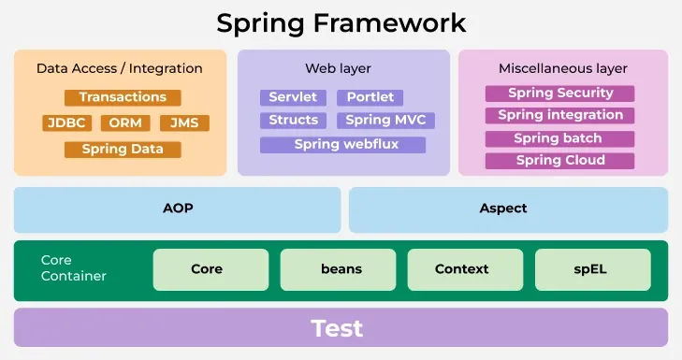

Slide 33
Core Container
Spring Core: This module provides the fundamental functionality of the Spring framework, including IoC and DI.
Spring Beans: This module provides the BeanFactory, which is the basic building block of the IoC container, and the BeanWrapper, which is responsible for managing the lifecycle of a bean. The Bean Factory is the core interface for accessing the IoC container. It provides methods for retrieving beans.
Spring Context: This module provides the ApplicationContext, which is an advanced version of the BeanFactory and provides additional features, such as internationalization and resource loading.
Spring Expression Language (SpEL): This module provides a powerful expression language for querying and manipulating objects during runtime.

